Slide 1
Algorithm Final Presentation
電機四 廖宜倫 B03901001
電機四 周晁德 B03901096

Slide 2
Outline
Idea
Algorithm
Result

Slide 3
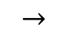
Idea (1/4)
Minimize the total time for all cars to pass
Match as many cars to pass at the same time as possible
Sequence Alignment [Algorithm Design P273]
$$→$$

Slide 4
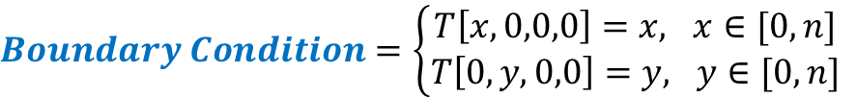
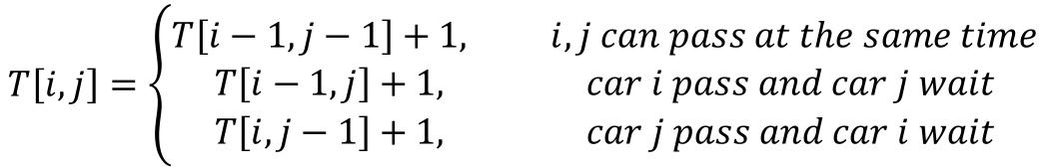
Idea (2/4)
N: 1E 00 1E 00 1S 1E 00 DP with induction on time
E : 00 1S 1S 1S 1N 00 1W
 | 0 | E | 0 | E | 0 | S | E | 0
0 | 0 | 1 | 2 | 3 | 4 | 5 | 6 | 7
0 | 1 | 1 | 2 | 3 | 4 | 5 | 6 | 7
S | 2 | 2
S | 3
S | 4
N | 5
0 | 6
w | 7
$Boundary Condition=\left\{\begin{aligned}T\left[x,0,0,0\right]=x, x∈[0,n] \\ T\left[0,y,0,0\right]=y, y∈[0,n]\end{aligned}\right.$
$$T\left[i,j\right]=\left\{\begin{aligned}T\left[i−1,j−1\right]+1, i,j can pass at the same time \\ T\left[i−1,j\right]+1, car i pass and car j wait \\ T\left[i, j−1\right]+1, car j pass and car i wait\end{aligned}\right.$$

Slide 5
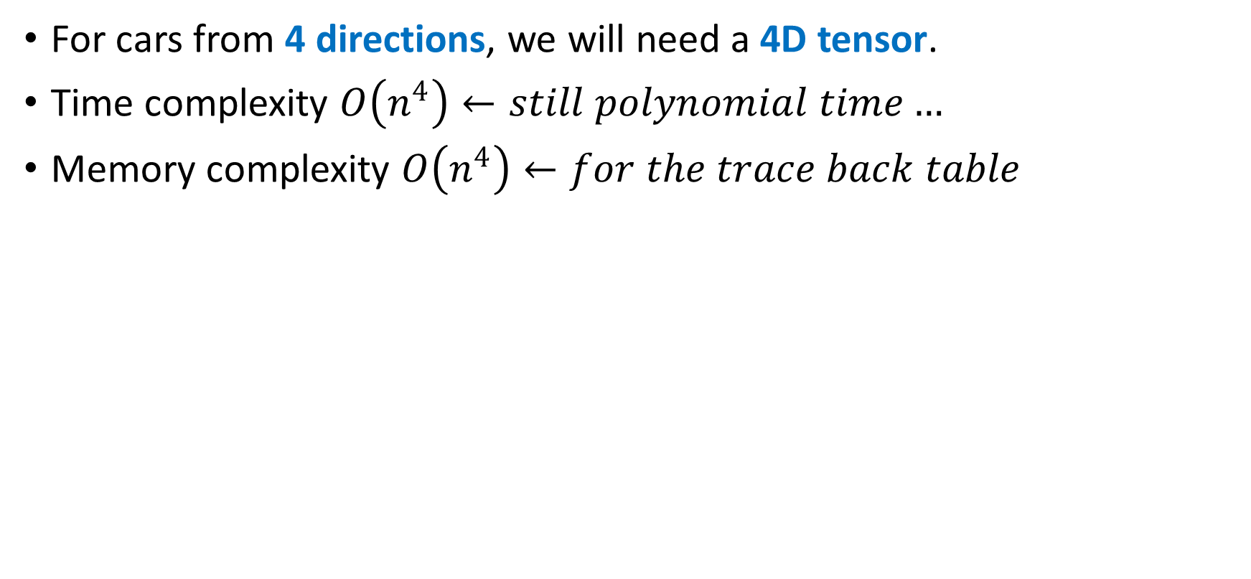
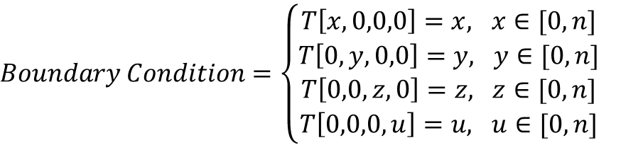
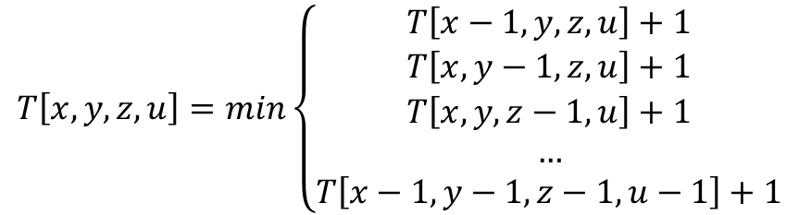
Idea (3/4)
For cars from 4 directions, we will need a 4D tensor.
Time complexity $O\left(n^{4}\right)←still polynomial time…$
Memory complexity $O\left(n^{4}\right)←for the trace back table$
$$T\left[x,y,z,u\right]=min\left\{\begin{aligned}T\left[x−1,y,z,u\right]+1 \\ T\left[x,y−1,z,u\right]+1 \\ T\left[x,y,z−1,u\right]+1 \\ … \\ T\left[x−1,y−1,z−1,u−1\right]+1\end{aligned}\right.$$
$Boundary Condition=\left\{\begin{aligned}T\left[x,0,0,0\right]=x, x∈[0,n] \\ T\left[0,y,0,0\right]=y, y∈[0,n] \\ T\left[0,0,z,0\right]=z, z∈[0,n] \\ T\left[0,0,0,u\right]=u, u∈[0,n]\end{aligned}\right.$

Slide 6

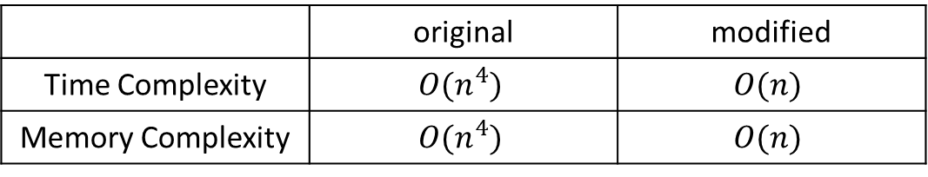


Idea (4/4)
 | E | 0 | E | 0 | S | E | 0
0
S
S
S
N
0
w
$$1$$
Fixed-sized window for dynamic programming table
Heuristic to choose a position as the start point for the next window
Greedy to refine the solution to each window
$$2$$
$$3$$
 | 0 | E | 0 | E | 0
0
0
S
S
S
 | original | modified
Time Complexity | $$O(n^{4})$$ | $$O(n)$$
Memory Complexity | $$O(n^{4})$$ | $$O(n)$$
Notes:
為了避免上述算4維tensor的問題，我們採用了DP的近似，每次只算一小部分的DP table，稱為window
在這樣的近似下，time complexity和memory complexity會變成是
Window 和window之間如何劃分，我們用了一個heuristic找出下次window的起始位置
做完一個window的DP後，traceback後得到的路徑可以用簡單的greedy來改善schedule

Slide 7
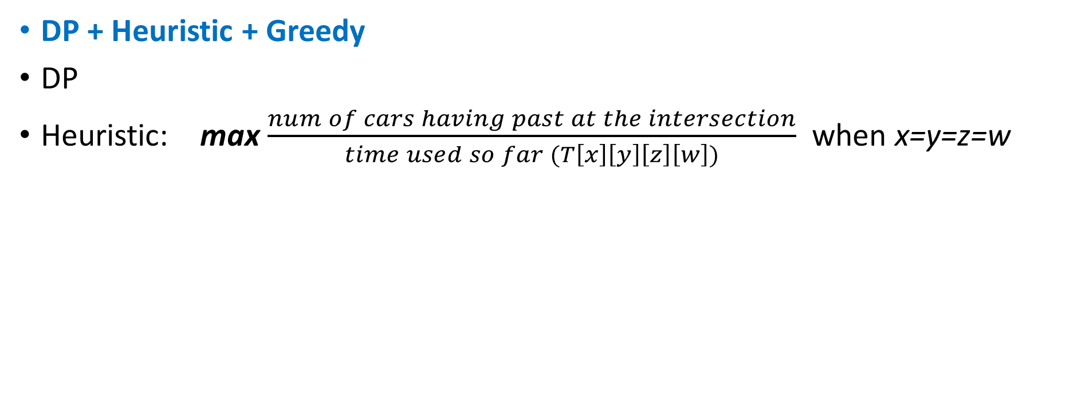



Algorithm (1/2)
DP + Heuristic + Greedy
DP
Heuristic: max $\frac{num of cars having past at the intersection}{time used so far (T\left[x\right]\left[y\right]\left[z\right]\left[w\right])}$ when x=y=z=w
 | E | 0 | E | 0 | S | E | 0
0
S
S
S
N
0
w
 | E | 0 | E | 0 | S | E | 0
0
S
S
S
N
0
w
$$1$$
$$1$$
$$2$$
Notes:
所以算法是這樣
先算一部分的DP
用上述的heuristic去找出下一個DP window的起始位置，
限制這個位置是4個座標都相同，
且單位時間通過的車子數量是最多的
因此，下一個window的起始位置會是這個

Slide 8
Algorithm (2/2)
Greedy
Place flows of multiple cars in front of those of a single car
N:
0 0 E 0 0 0 E 0 0 S 0 0 0 E
E:
0 0 0 S S S N 0 0 0 W 0 0 0
S:
0 0 0 E E E 0 0 0 E 0 E W 0
W:
E E 0 0 0 0 0 E N 0 E 0 0 0
N:
0 0 0 0 0 E E S 0 0 0 0 0 E
E:
0 S S S 0 0 N 0 0 0 W 0 0 0
S:
0 E E E 0 0 0 E 0 0 0 E W 0
W:
E 0 0 0 E 0 0 0 E N E 0 0 0
Notes:
Greedy的部分，因為DP 找出的是最短時間，所以會有上面單輛車先過，多輛車較慢通過的問題
這裡是直接將多輛車安排在單輛車之前

Slide 9
Result
Use window size = 50
 | Input 1 | Input 2 | Input 3 | Input 4 | Input 5 | case1 | case5 | case10
Average waiting rounds | 0.667 | 0.31578 | 2.95 | 2.6975 | 3.15 | 44.2648 | 161.599 | 337.939
Execution time (sec) | 0.01 | 0.01 | 0.01 | 0.01 | 0.01 | 2.252 | 12.645 | 25.145
Notes:
使用DP window大小為50，在工作站上測試的結果

